Slide 1
PROJECT TITLE
Prediction Of Full Load Electrical Power Output Of a Base Load Operated Combined Cycle Power Plant Using Machine Learning

Slide 2
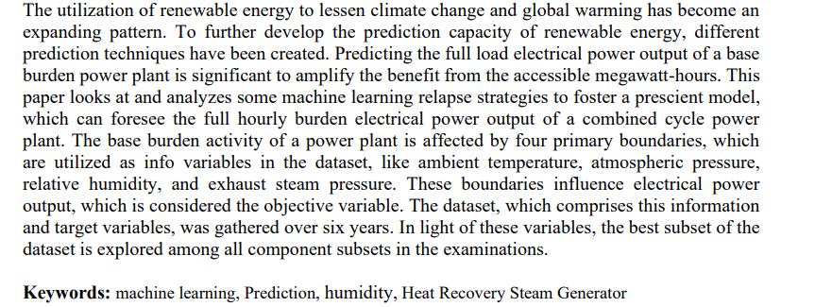
Abstract :-

Slide 3
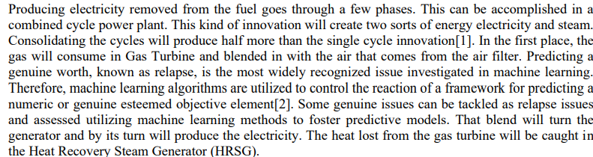
Introduction

Slide 4
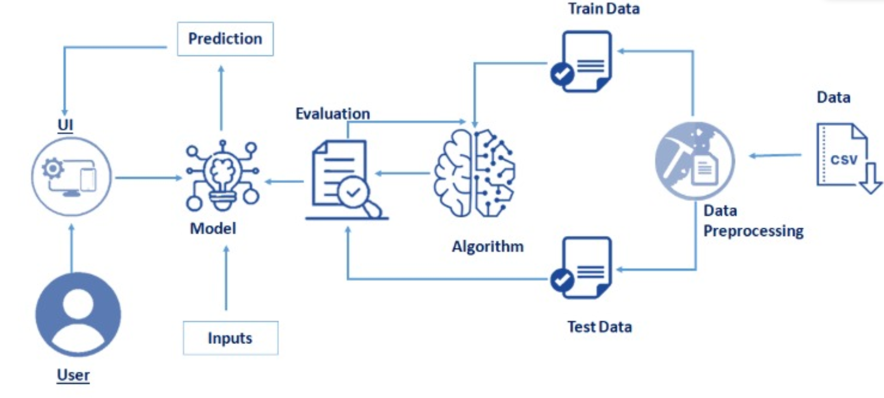
ARCHITECTURE

Slide 5
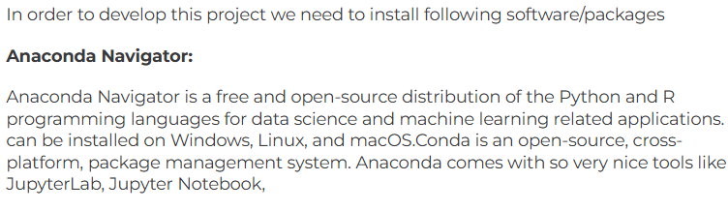

SOFTWARE INSTALLATION

Slide 6
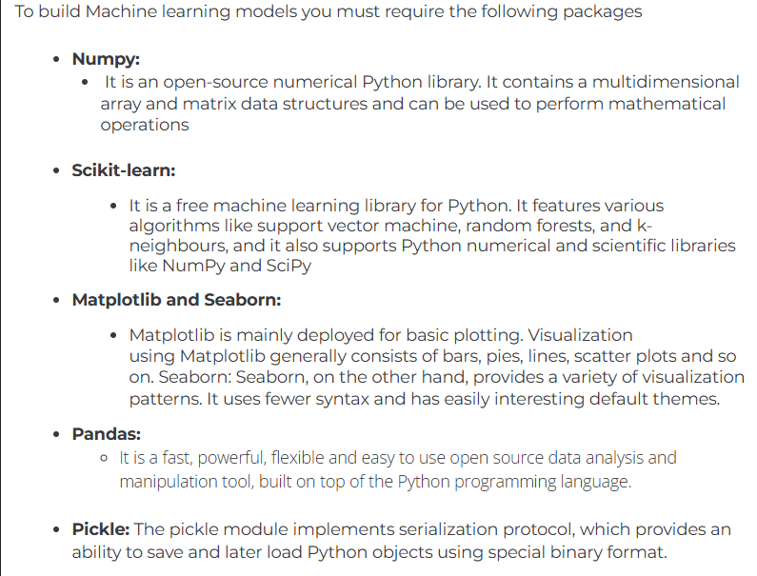

Slide 7
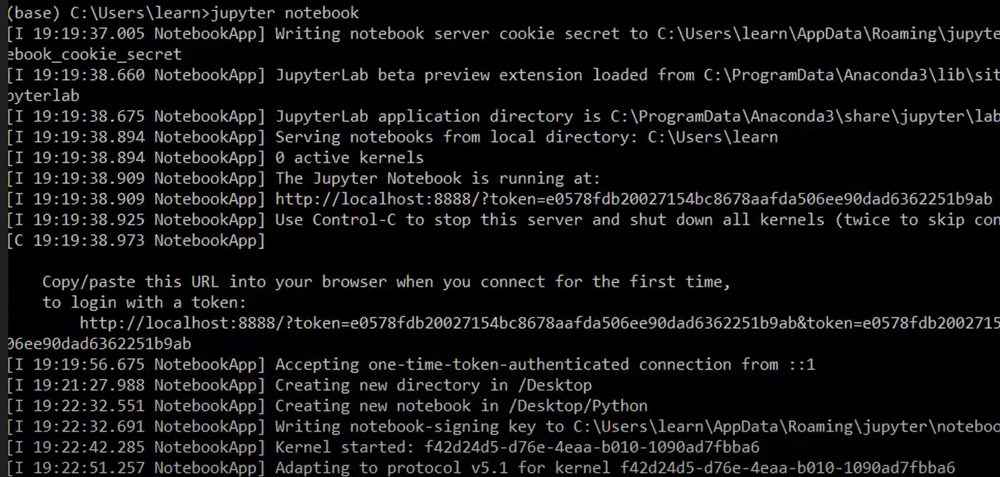

Slide 8
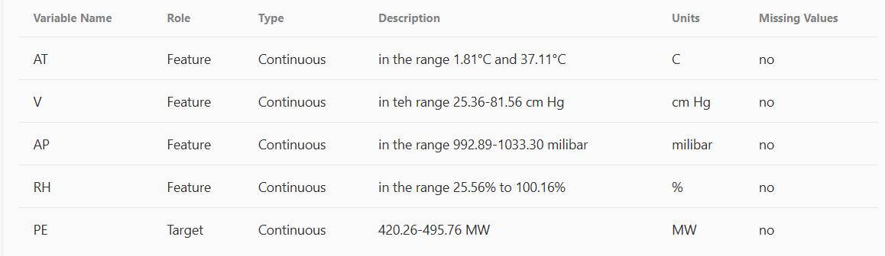
Data Collection:-

Slide 9
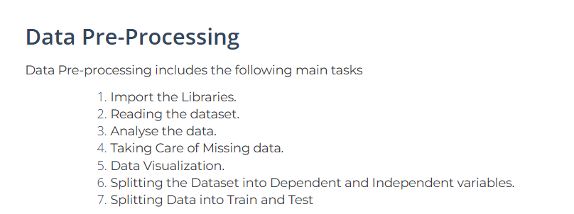
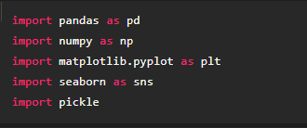

Slide 10
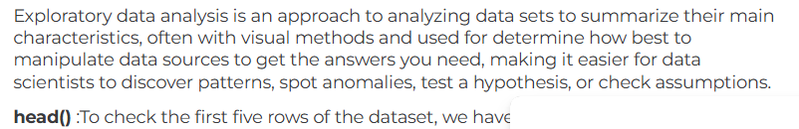
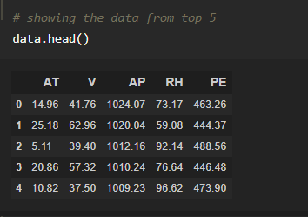
Exploratory Data Analysis

Slide 11
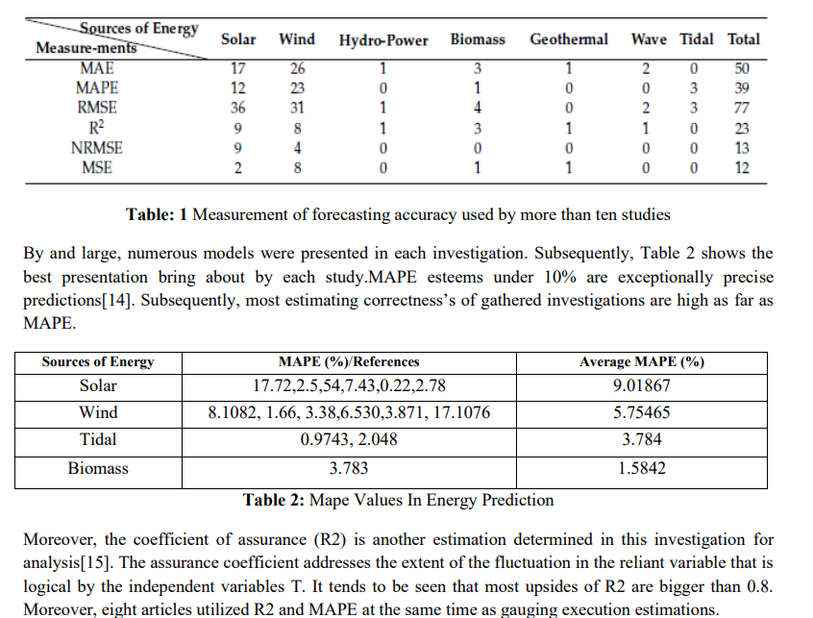
Result :-

Slide 12
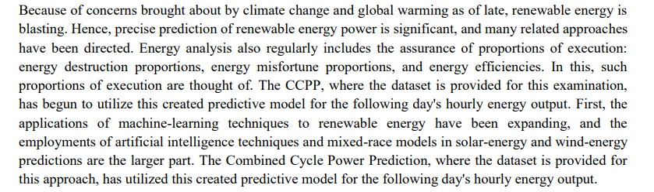
Conclusion

